Slide 1
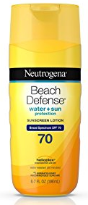
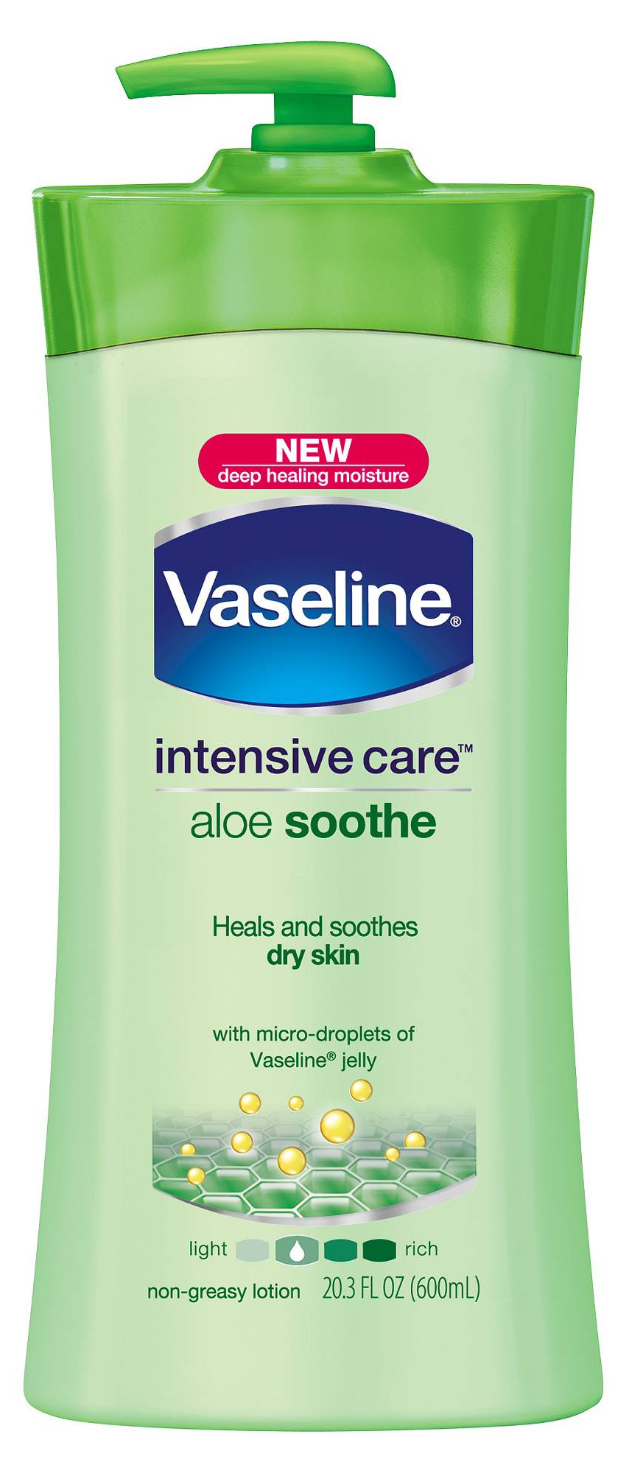
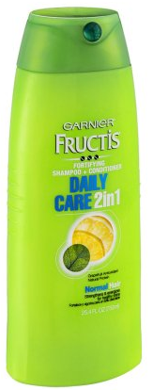


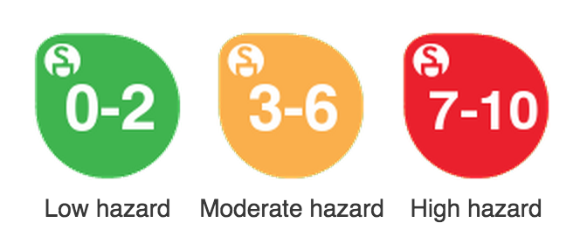
Reduce Toxins With A PURE Product Swap
Follow These Steps to Reduce Moderate to High Hazard Chemicals Now
Replace These Products
With Any Of These Products
Badger Sport Sunscreen Cream, Unscented, SPF 35
ThinkSport Kids Sunscreen, SPF 50+
Goddess Garden Organics Sport Natural Sunscreen Lotion, SPF 50
Herbaliz Aloe & Shea Moisturizing Lotion
ATTITUDE Super Leaves Natural Body Cream
Just The Goods Vegan Hand + Body Lotion, Unscented
California Baby Swimmer's Defense Shampoo & Bodywash and Hair Conditioner
ATTITUDE Super Leaves Natural Shampoo & Body Wash 2-in-1 Sports
Herbaliz Shampoo and Herbal Vinegar Hair Rinse
To Reduce Chemicals Linked To:
Biochemical or cellular level changes
Endocrine (hormone) Disruption
Allergies and Immunotoxicity
Organ System Toxicity
Chemical Information Source: Environmental Working Group
EWG’s
Hazard Score Key:

